Slide 1
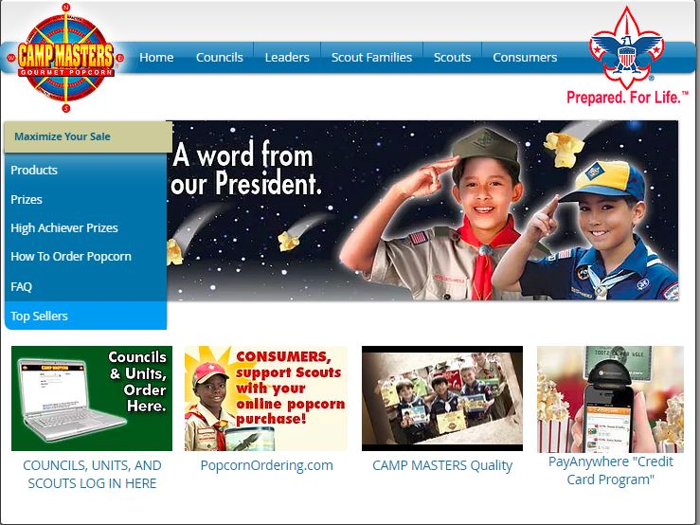
CM SYSTEM GUIDE #5 Scouts 2019
Registration ** Enter Take Orders Electronically ** Sell Online
*CURRENT SCOUTS – UNIT LEADER WILL EMAIL SINGLE-SIGN ON LINK; EMAIL WILL BE FROM customerservice@campmasters.org
NOTE: EACH SCOUT MUST HAVE A UNIQUE EMAIL AS THEIR LOGIN.
LOG IN SCREEN, CLICK THE LINK FOR NEW SCOUTS TO SELF-REGISTER OR TO “FIND” YOUR SCOUT ACCOUNT IF PREVIOUSLY REGISTERED
ACCESS ALSO VIA WWW.CAMPMASTERS.ORG
FOR SIGN ON PAGE – see bottom left on screen “Council/Units/Scouts Log In Here”. The page will be redirected to the SIGN ON PAGE to Register or “Find” your Scout Account.
** use Google Chrome or Firefox Web Browser
www.popcornordering.com

Slide 2
SCOUTS: SELF-REGISTER OR “FIND” YOUR SCOUT ACCOUNT
EXISTING SCOUTS ACCESS DIRECTLY TO THE CM ORDERING SITE WITH THE “EMAILED SINGLE SIGN-ON” LINK FROM YOUR UNIT LEADER. IF YOU DO NOT RECEIVE AN EMAIL, ACCESS VIA WWW.CAMPMASTERS.ORG FOR THIS SIGN ON PAGE
CLICK THE BLUE LINK - NEW SCOUTS TO SELF-REGISTER; CURRENT SCOUTS CAN “FIND” THEIR ACCOUNT BY CLICKING THIS LINK.

Slide 3
Fill in all required fields to Self Register or to Find your Scout Account. Click “Continue” when finished.

Slide 4
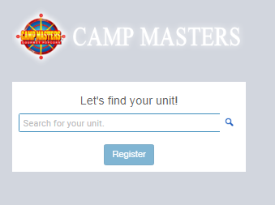
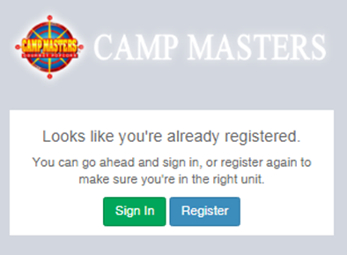
In the field “Let’s find your unit”, enter your Unit Number & type. Example: “Pack 4071” System will display options. (If your Unit does not display, you can enter a zip code or Unit Leader Name.)
Click on the correct Unit to select your Unit.
If you get the message below you are already registered in the system. You can go ahead and sign in, OR click Register to make sure you are in the correct Unit or to MOVE Scout to a NEW/Different Unit. You will then search for the new Unit by typing in the new Unit number in “ Lets find your Unit”

Slide 5
Click “Register”. You will receive an email from customerservice@campmasters.org with a Sign-On Link to finish your Registration and access the CM System.

Slide 6
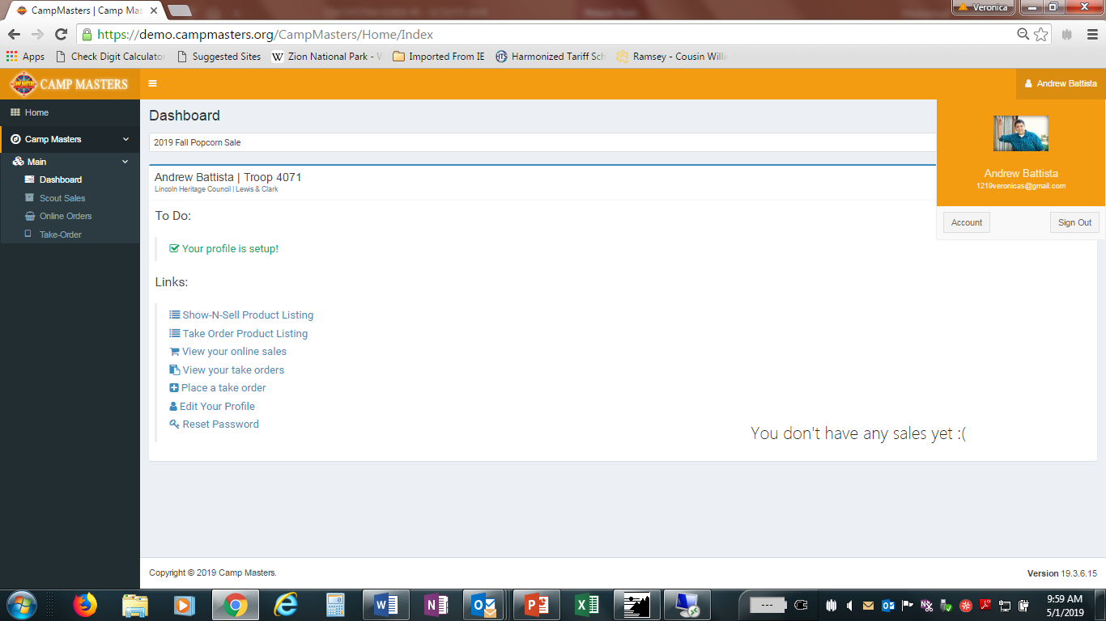
FIRST TIME LOG IN TO CM SYSTEM, the DASHBOARD will display YOUR information – Name, Unit#, Council Name, and District Name. If this is NOT your information please contact your UNIT LEADER.
Click under SCOUT NAME, “Account” to update set a secure password & change/update your email. **If you forget your password, go to the log-in screen, type your email, and click “forgot password”. System will send you an email to reset your OWN password.

Slide 7
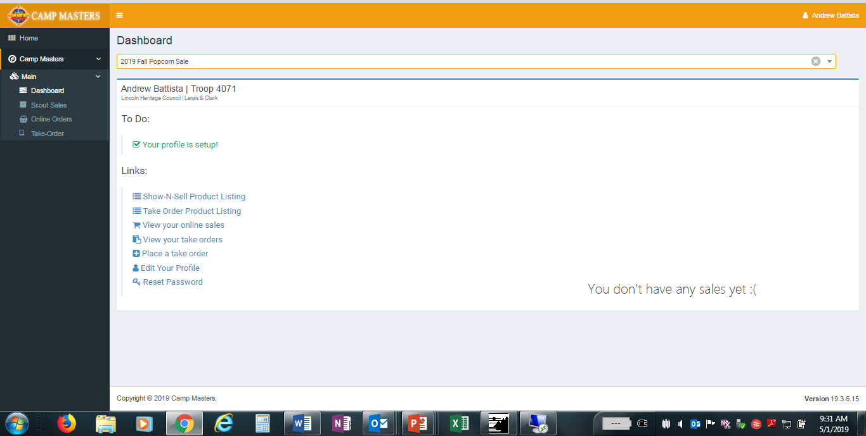
SET UP PROFILE, ADD IMAGE, & EMAIL CUSTOMERS YOUR KEYCODE SO THEY CAN PLACE ORDERS ONLINE VIA THE CM ONLINE SHOPPING CART: www.popcornordering.com. These orders are shipped directly to the CUSTOMER.
Under “Links”
Scout can VIEW customer online orders
Scout can enter TAKE ORDERS**
**Scouts are not required to enter Take Orders in the system. They can still turn in their TAKE ORDER FORM to the Unit Leader and the UNIT LEADER will enter these orders for the Scout. DO NOT ENTER AND GIVE TO UNIT LEADER OR YOUR ORDER COULD BE PLACED TWICE. ALL TAKE ORDERS are shipped to Council & distributed to the UNIT LEADER.

Slide 8
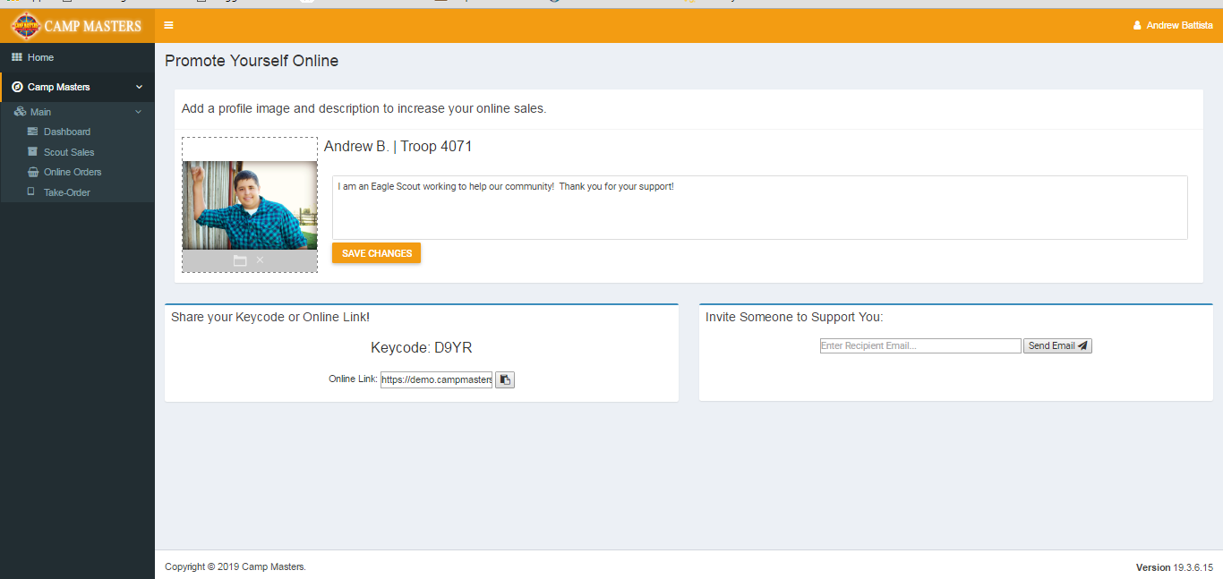
Scout can upload picture & write a personal note in box provided. Email friends and family using the field “Invite Someone to Support You”. The email will contain a link to take the consumer directly to the Scout’s ordering page: www.popcornordering.com*
* Consumers can still just go directly to URL: www.popcornordering.com and enter the New Scout Keycode. To get credit for the Sale, the consumer must enter the Keycode. PLEASE NOTE: All keycodes are NEW for 2019. The page will display the Scout Name that is getting credit for the online sale.

Slide 9
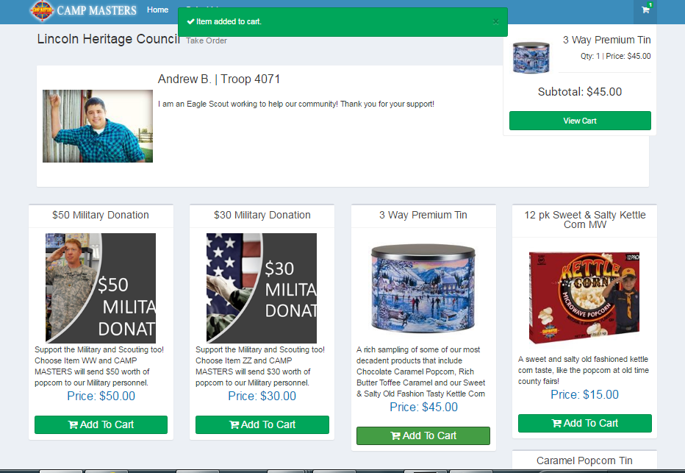
DIRECTIONS FOR SCOUT TO ENTER CUSTOMER TAKE ORDER USING THE CAMP MASTERS SYSTEM. FROM YOUR SCOUT DASHBOARD, click the link “Place a Take Order”. System will show the products available to select for your customer. Click “Add to Cart”. If finished, click “View Cart”

Slide 10
SCOUT ENTERING CUSTOMER TAKE ORDER
Enter Customer information so you know who ordered & where to deliver.
CUSTOMER MUST PAY SCOUT FOR ALL TAKE ORDERS. If they pay cash/check/etc. check mark “Paid”. It is recommended that funds be collected at time of order rather than at delivery to customer.
When complete, click “PLACE ORDER”

Slide 11
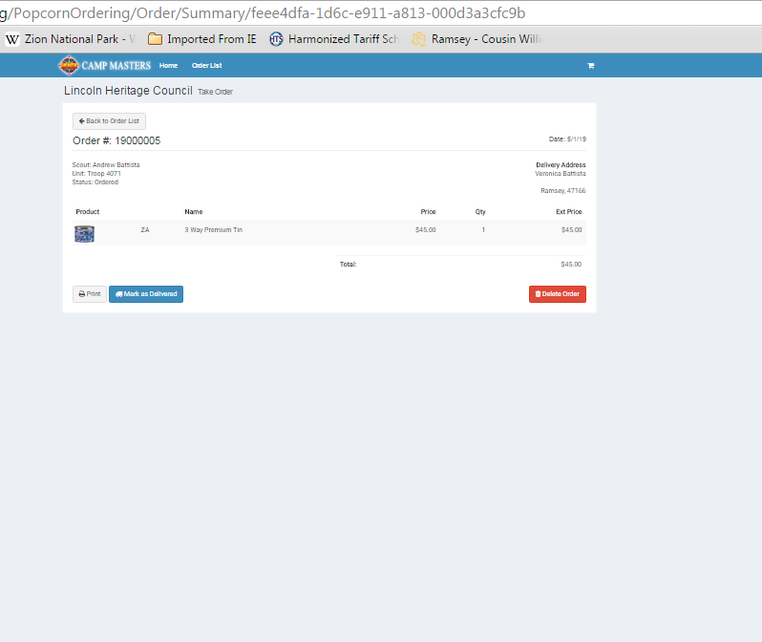
SCOUT ENTERING CUSTOMER TAKE ORDER
Screen will display the order as submitted.
If you made a mistake, you can DELTE.
CLICK “HOME” to go back to your DASHBOARD or CLICK “ORDER LIST” to VIEW TAKE ORDERS that Scout has entered into the CM system.
IMPORTANT: YOUR UNIT LEADER WILL SEE ALL OF THE SCOUT TAKE ORDERS.
TO INSURE THERE IS NO DUPLICATION, DO NOT TURN IN YOUR PAPER “TAKE ORDER FORM”. ONLY TURN IN THE PAPER FORM IF SCOUT IS NOT ENTERING TAKE ORDERS IN THE SYSTEM.

Slide 12
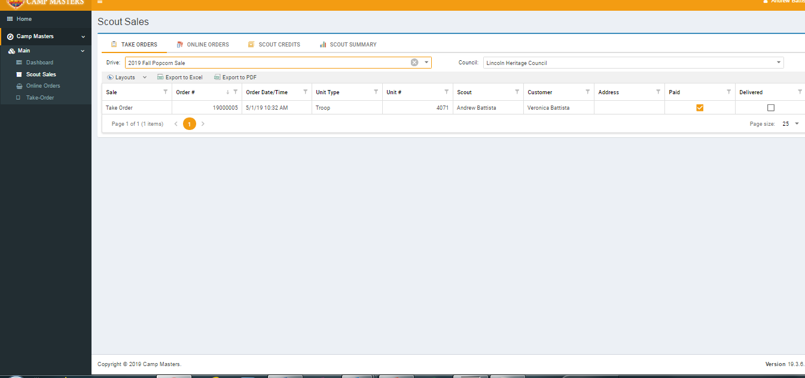
VIEW OF SCOUT CUSTOMER TAKE ORDERS AS ENTERED INTO THE CM SYSTEM

Slide 13
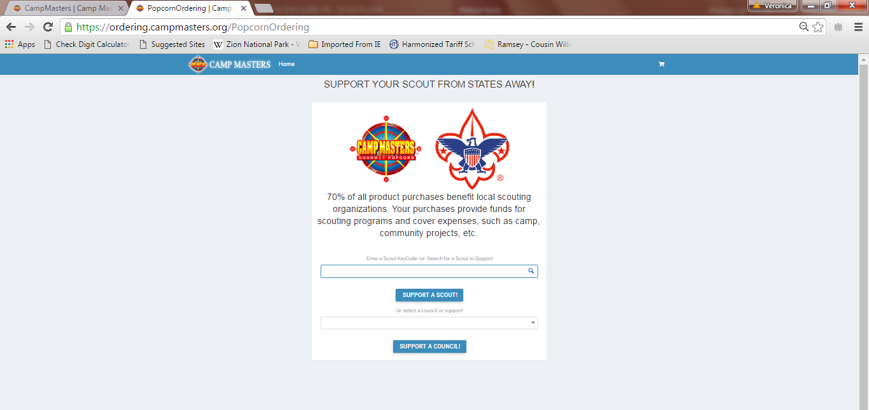
WWW.POPCORNORDERING.COM - SCOUTS SELL ONLINE
ORDERS SHIPPED DIRECTLY TO THE CUSTOMER –Below is what Consumers will see:

Slide 14
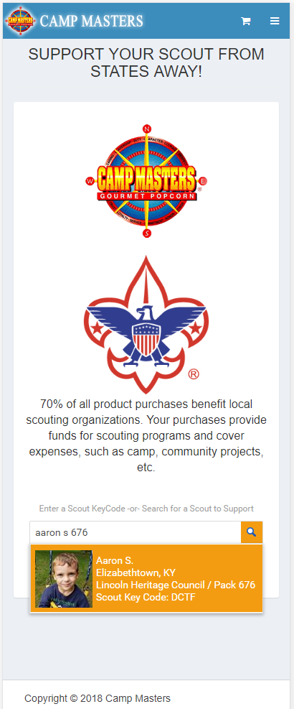
Scout “look up” from a laptop or tablet.
Scout “look up” from Mobile device

Slide 15
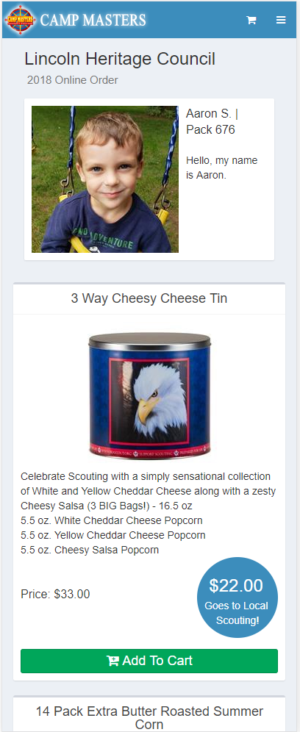
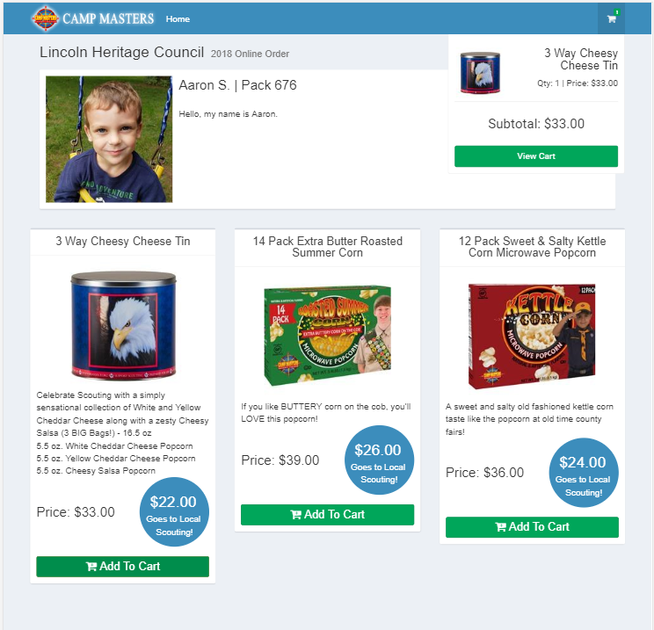
www.popcornordering.com
CONSUMER VIEW IF USING A MOBILE DEVICE
WHEN THE CONSUMER ENTERS THE KEYCODE OR “FINDS” THEIR SCOUT, THEY WILL SEE SCOUT INFORMATION & THE PRODUCTS TO ADD TO CART

Slide 16
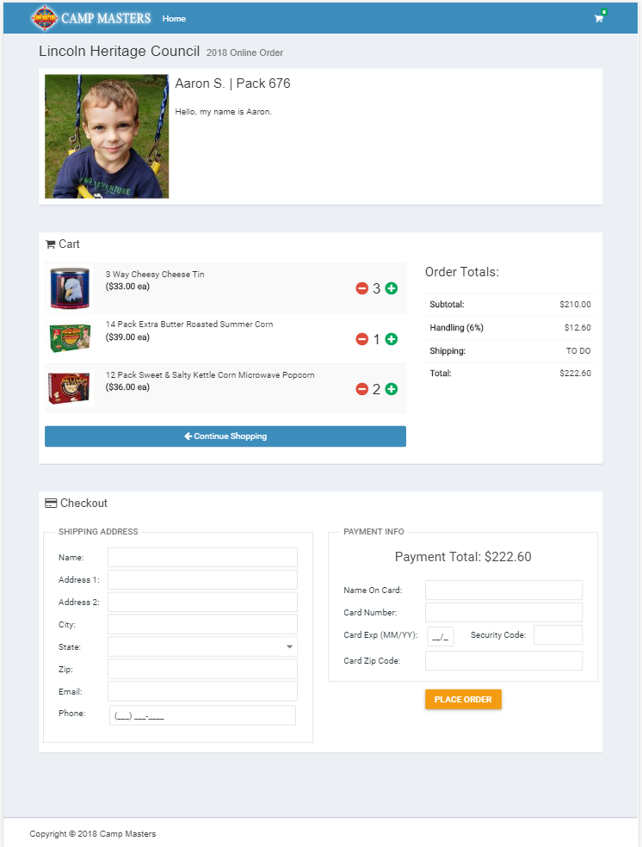
www.popcornordering.com
SCOUT ONLINE SELLING- CONSUMER “CHECK OUT”
CONSUMER WILL BE EMAILED ORDER CONFIRMATION
ORDER IS SHIPPED DIRECTLY TO CONSUMER
PAYMENT IS MADE TO THE ORDERING SYSTEM; SCOUT DOES NOT HAVE TO DELIVER PRODUCT OR TAKE PAYMENTS
SCOUT RECEIVES CREDIT FOR THE SALE

